Slide 1

Object Oriented Programming (in )
CS 1181 – Computer Science II
Dr. Michael Raymer
Lecture materials adapted from:
ZyBooks ISBN: 979-8-203-16123-9 Dr. Cay Horstmann, Univ. of Michigan Dr. Roman Lysecky, Univ. of Arizona
Dr. Adrian Lizarraga, Univ. of Arizona
Dr. Travis Doom
Dr. Michelle Cheatham
Unless otherwise noted images are used under the creative commons license or used under license from Adobe Stock.

Slide 2

public class HelloWorld {
public static void main(String[] args) {
int i = 7;
System.out.println(i);
}
}

Slide 3
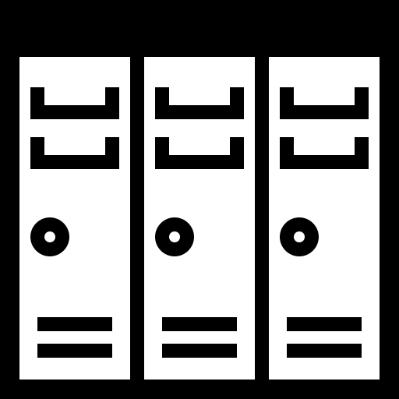
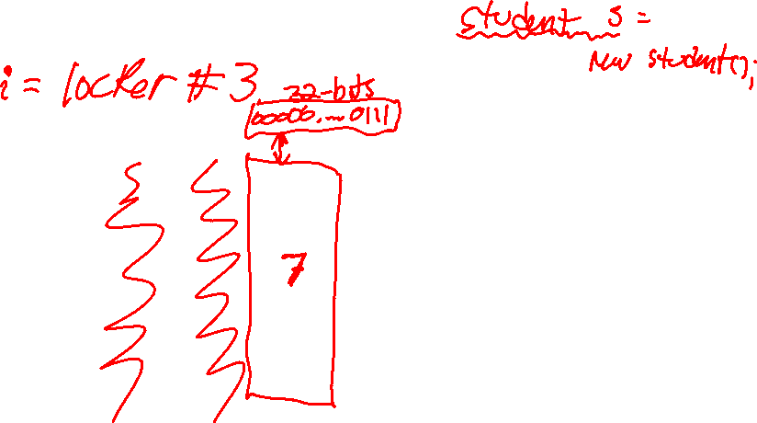
Understanding RAM
001
002
003
004
005
006

Slide 4
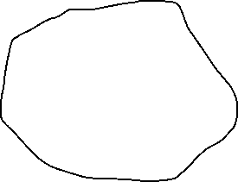

Data Types in Java
There are two kinds of data in Java
Intrinsic variables
Reference variables/Objects
int count
372
Student me
Name: “mike”
UID: 0011232

Slide 5
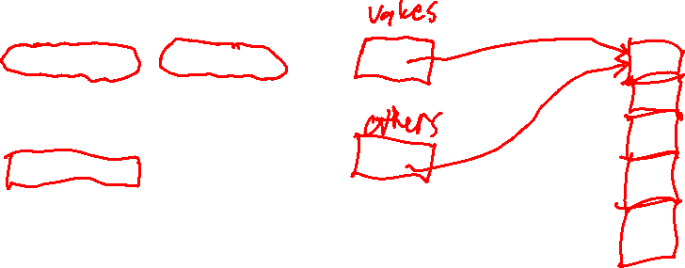
public class HelloWorld {
public static void main(String[] args) {
//int i = 7;
//System.out.println(i);
int[] values = new int[5];
for (int j = 0; j <5; j++){
values[j] = j * 2 + 7;
}
int[] others = values;
others[2] = -111;
for (int j = 0; j < 5; j++){
System.out.println(values[j]);
}
}
}

Slide 6
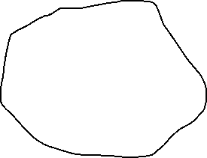

Two References to the Same Object
Student me
Name: “mike”
UID: 0011232
Student you

Slide 7
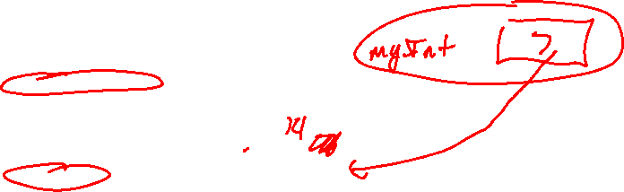
Intrinsic variables are passed by value
A copy is sent to the method
public class DataTypes{
public static void main(String[] args) {
int myInt = 7;
changeInt(myInt);
System.out.println("myInt: " + myInt);
}
public static void changeInt(int value){
System.out.println("Before change: " + value);
value *= 2;
System.out.println("After change: " + value);
}
}
Before change: 7
After change: 14
myInt: 7

Slide 8
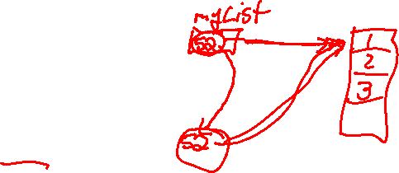
Objects are passed by reference
A reference is sent to the method
public class DataTypes{
public static void main(String[] args) {
ArrayList<Integer> myList = new ArrayList<>(Arrays.asList(1, 2, 3));
changeInts(myList);
System.out.println("myList: " + myList);
}
public static void changeInts(ArrayList<Integer> values){
System.out.println("Before change: " + values);
for (int i = 0; i < values.size(); i++){
values.set(i, values.get(i) * 2);
}
System.out.println("After change: " + values);
}
}
Before change: [1, 2, 3]
After change: [2, 4, 6]
myList: [2, 4, 6]

Slide 9


Objects are passed by reference
A reference is sent to the method
public class DataTypes{
public static void main(String[] args) {
ArrayList<Integer> myList = new ArrayList<>(Arrays.asList(1, 2, 3));
changeInts(myList);
System.out.println("myList: " + myList);
}
}
1
myList
2
3
ArrayList<Integer>

Slide 10
Automatic boxing and unboxing
Each intrinsic/primitive datatype has a matching “wrapper” class
int ↔ Integer
double ↔ Double
boolean ↔ Boolean
double ↔ Double
etc…
Boxing – converting an intrinsic variable to an object
Unboxing – converting an object to an intrinsic variable

Slide 11
Promotion and coercion
Java will automatically promote variables when needed
Smaller → larger data = no loss
Try it out with int, float, double, boolean??
When reducing data type size, you must explicitly typecast
i = (int) d;

Slide 12
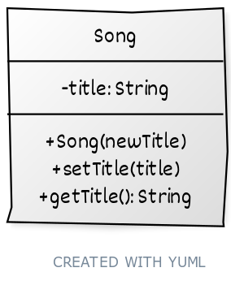
Classes and Objects
Classes have:
Fields (member data)
Methods (functions)

Slide 13
Encapsulation
Getters and setters catch bad data early!
public class Square {
private int sideLength;
public Square(int sideLength){
setSideLength(sideLength);
}
public void setSideLength(int newLength){
// Squares must have a positive side lenghth!
if (newLength <= 0){
throw new RuntimeException("Negative side length not allowed");
}
sideLength = newLength;
}
}
(What does this class look like in UML?)

Slide 14
Programming Style
Variable names & case
JavaDoc
Classes:
Methods:
/***
* Song - a class to hold song details
*
* @author Michael Raymer
* @since 1/12/2024
* @reference
*/
public class Song {
private String title; // Title of the song
/***
* Song - Create a new song with a title
*
* Detailed description of the constructor goes here.
* It can be multiple lines
*
* @param newTitle - The title of the new song
*/
public Song(String newTitle){
title = newTitle;
}

Slide 15
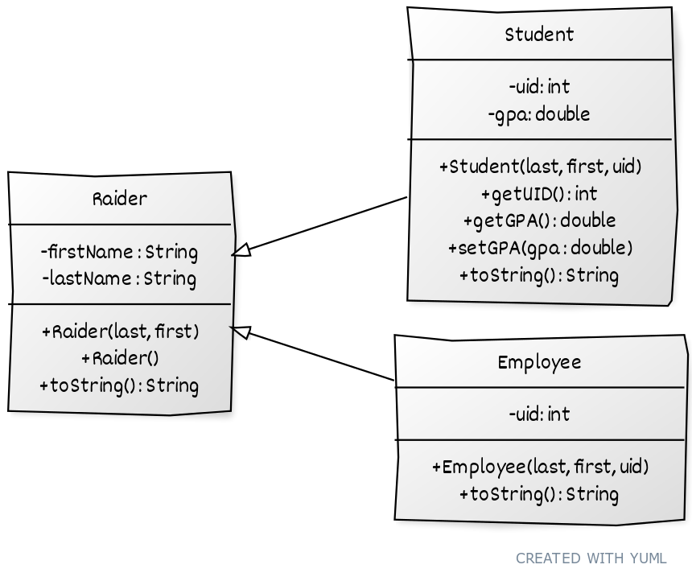
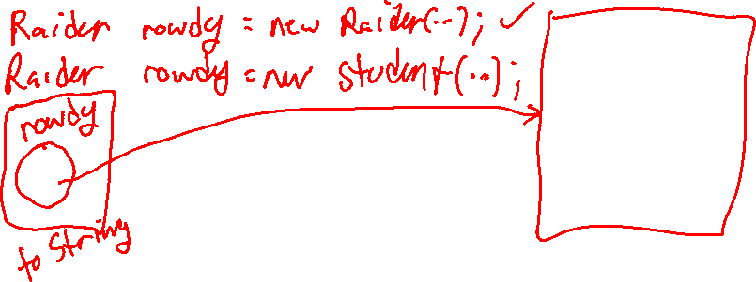
Inheritance
We get all the fields and methods of another class in one line of code. No code copying!
Is-a
Is-a

Slide 16
Polymorphism: Overriding methods
@Override prevents method name typos
super() calls the superclass constructor
super.methodName() calls superclass methods
Use these to avoid re-typing/copying code!

Slide 17
Polymorphism
One name, many methods
Raider me
Child class methods override parent methods
Reference variable determines which methods can be called
Object type determines which version of a method is called
Class Student
lastName: “Raymer”
firstName: “Mike”
UID: 00001234
GPA: 3.85

Slide 18
Local and Instance Variables
Memory: The Stack and the Heap
Variable shadowing
this
Raider me
Class Student
lastName: “Raymer”
firstName: “Mike”
UID: 00001234
GPA: 3.85

Slide 19
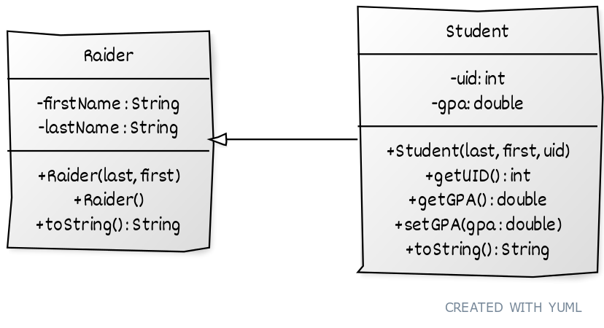
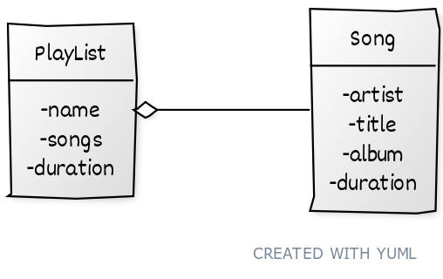
Inheritance vs Containment
Is-a
Has-a

Slide 20
Abstract Classes
Useful when we only want subclasses
Contain data, methods (with default code), and abstract methods, which must be defined by the child class
public abstract class Shape {
…
public abstract void draw();
}

Slide 21
Interfaces
More limited than abstract classes
Interfaces say nothing about what data a class should have
Interfaces define how a class should behave
All methods in an interface are abstract
public interface Drawable {
public void draw();
}

Slide 22

Recap
Abstract Class
Interface
May have fields
Has code for some methods
Can be overridden
Has abstract methods
No fields*
No code*
Has abstract methods
*I’m lying about this, but don’t worry about it until later.

Slide 23
Java Inheritance
You can extend (inherit from) only one Class (regular or abstract)
You can implement any number of interfaces
You can make a reference variable to an abstract class or an interface (e.g. lists)
public class Square extends Shape implements Drawable, Resizable {
…
}

Slide 24
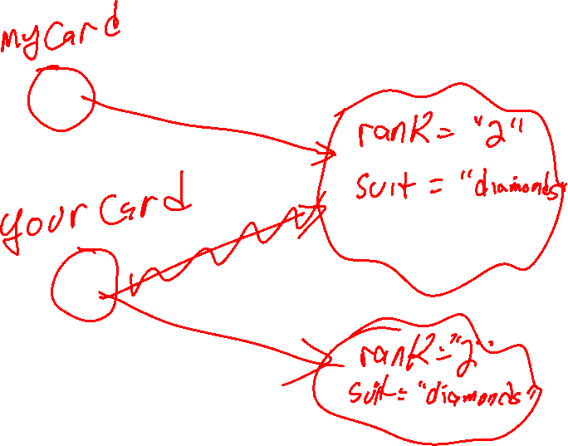

Slide 25
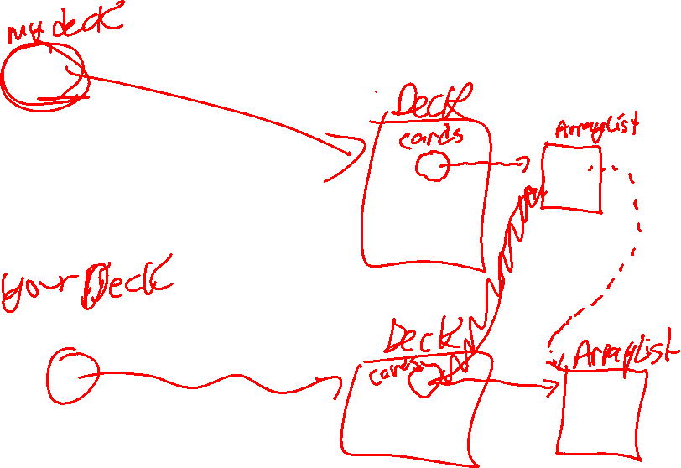

Slide 26

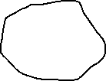
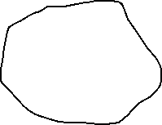
Advanced Topic: Deep Copies
Deck
Card
deck1
ArrayList<Card> cards;
ArrayList
String suit;
String rank;
Card
String suit;
String rank;
Card
String suit;
String rank;

Slide 27




Advanced Topic: Deep Copies
Deck
Card
deck1
ArrayList<Card> cards;
ArrayList
String suit;
String rank;
Card
String suit;
String rank;
Card
String suit;
String rank;
deck2

Slide 28
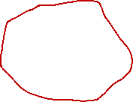
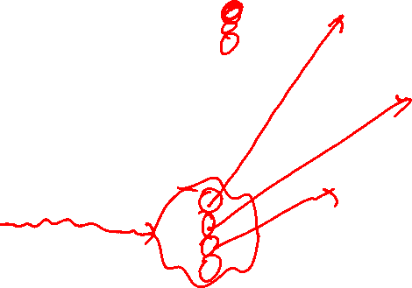
Advanced Topic: Deep Copies
Deck
Card
deck1
ArrayList<Card> cards;
ArrayList
String suit;
String rank;
Card
String suit;
String rank;
Card
Deck
String suit;
String rank;
deck2
ArrayList<Card> cards;

Slide 29

Advanced Topic: Deep Copies
Deck
Card
deck1
ArrayList<Card> cards;
ArrayList
String suit;
String rank;
Card
String suit;
String rank;
Card
Deck
String suit;
String rank;
deck2
ArrayList<Card> cards;
ArrayList

Slide 30


Advanced Topic: Deep Copies
Deck
Card
deck1
ArrayList<Card> cards;
ArrayList
String suit;
String rank;
Card
String suit;
String rank;
Card
Deck
String suit;
String rank;
deck2
ArrayList<Card> cards;
ArrayList
Card
String suit;
String rank;
Card
String suit;
String rank;

Slide 31
Advanced Topic: Deep Copies
Deck
Card
deck1
ArrayList<Card> cards;
ArrayList
String suit;
String rank;
Card
String suit;
String rank;
Card
Deck
String suit;
String rank;
deck2
ArrayList<Card> cards;
ArrayList
Card
String suit;
String rank;
Card
String suit;
String rank;

Slide 32
Do you remember?
Static vs Instance variables
Static methods in a class
Arrays vs ArrayLists
Files and Scanners
System.out
Review videos in Pilot: → Content / Review Materials / CS 1180 Lectures – Dr. Doom

Slide 33

Today’s Quiz Password
java

Slide 34

Today’s Quiz Password
super

